Slide 1
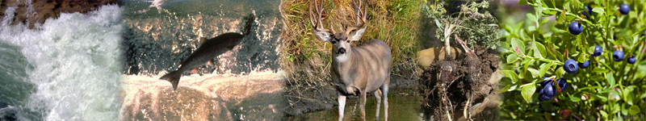
DNR Data Management Improvement Project
“To grow DNR Data Management Maturity
to provide reliable and timely data to
enrich and inform decisions.”
Notes:
I am here today to talk to you about the DNR Data Management Improvement Project. This project was brought about in order “To grow DNR data management maturity to provide reliable and timely data to enrich and inform decisions.”

Slide 2
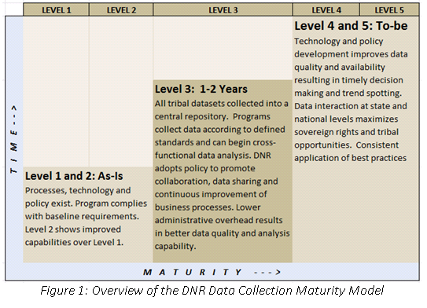
Part of a long-term plan for improving Data Management

Slide 3
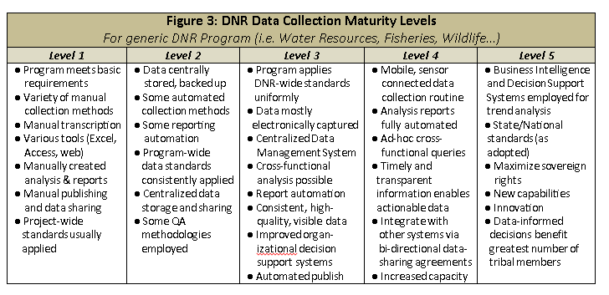
Goal: Enterprise data management

Slide 4
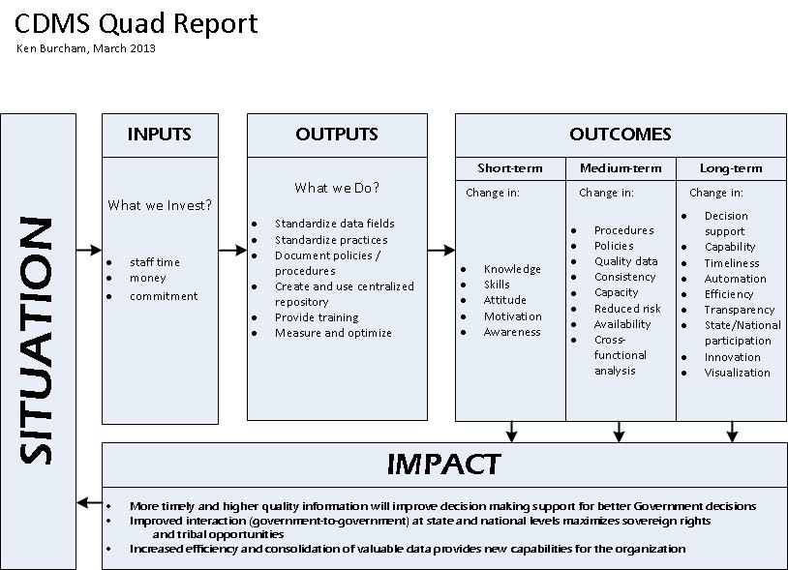

Slide 5
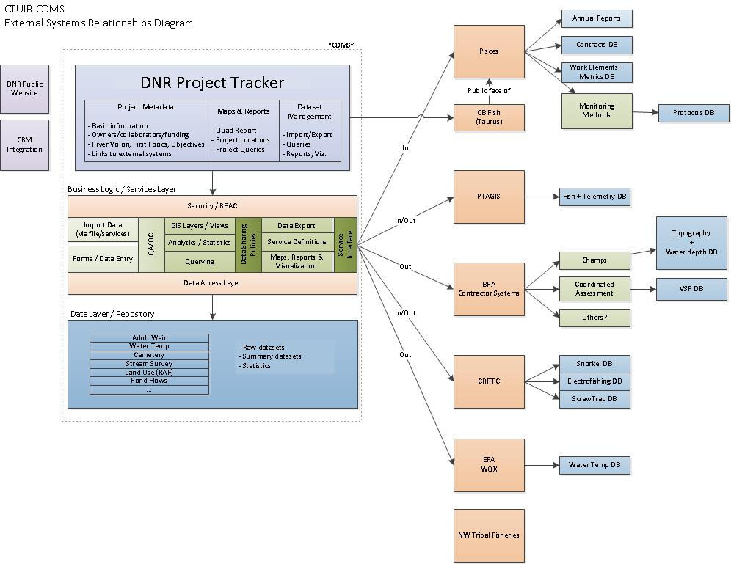

Slide 6
Project Tracker a basic Project Management tool
Project Information (Quad report type info)
Purpose & Goal
Inputs/Outputs/Outcomes/Impacts
Relate to River Vision Touchstone, First Foods
Habitat Objectives
Image Gallery
Document Repository
View/Print “Quad Report”

Slide 7
Project Tracker: Datasets Centralized data management
Data Standardization / Validation
Import (Excel, CSV, TSV, etc.)
Excel-like Data Entry
Ad-hoc Query Tool
Export
Row-level Auditing
QA/QC/Workflow
Reports

Slide 8
One bucket, many slices
Reports
Water Resources
Exports
Import Data
WR Temp Dataset View
Water Temp Dataset (All)
Publish Data
Data Logger .csv
QA
Website Widgets
Import Data
GR Habitat
GR Temp Dataset View
Queries
GIS
Notes:
How does the CDMS work for Water Temperature?

Slide 9
Project Tracker Training
Project Tracker Introduction
Creating a new project
Managing a project
Project Information / Metadata
Image Gallery
Document Repository
Deleting a project
Data data.ctuir.org/cdms

